Slide 1

Performance Assessments, An Essential Component of a Modern Quality Management System
John W. Quidley, SET
Sara B. Clark
January 26, 2021
Notes:
Find out how NICET’s highly regarded CMT certifications, now paired with performance examinations to meet hands-on requirements, are an essential component of a modern quality management system.
Performance Examination Administrator, John Quidley, will guide participants through the process, review available performance examinations, discuss what to expect on assessment day, and more.
Additionally, NICET’s Manager of Certification Program Development, Sara Clark, will provide administrative information on NICET recognition.

Slide 2

Chip Hollis
Notes:
Chip Hollis is the Senior Director of Credentials and Administration for NICET.
Mr. Hollis is responsible for implementing the policies and directions established by the NICET Board of Governors and daily operations. He promotes the value of NICET certification to technicians, employers, contract specifiers, AHJs and other stakeholders. He strives to create a customer friendly environment and improve processes while preserving the rigor and integrity of NICET certifications.

Slide 3


John W. Quidley, SET
Notes:
John W. Quidley, SET
John Quidley is currently President and Senior Quality Consultant with Caliber Consulting Services, LLC. His role has involved helping businesses, serving as their Laboratory & Quality System Consultant, developing quality systems that meet industry standards, and ensure profitability. John’s experience of 27 years in the civil construction industry includes a consistent record of improved quality control through effective planning and performance management.

Slide 4

Sara B. Clark
Notes:
Sara B. Clark
Sara Clark is the Manager of Certification Program Development at the National Institute for Certification in Engineering Technologies (NICET) with more than 10 years’ experience in certification test development and maintenance. Sara oversees the development and maintenance activities for NICET’s 13 multi-level career track certification programs in Mechanical, Electrical, and Civil fields. She manages staff, allocated budgets, numerous industry volunteers and subject matter experts, and psychometric consultants to keep development and maintenance activities on schedule.

Slide 5


45,000 Active Certifications
154,000 Certifications Issued
More than 10,000 Tests Annually
We Provide:
Nationally-applicable, career track, voluntary certification programs.
Independent 3rd Party Certification - no training provided.
Founded in 1961
Division of NSPE
Not for Profit
www.nicet.org

Slide 6
NICET Certifications
Civil Engineering Technology
  Construction Materials Testing (with optional Performance Examinations)
      Asphalt
      Concrete
      Soils
  Transportation Construction Inspection
      Highway Construction Inspection
Electrical & Mechanical Engineering Technology
  Electrical Power Testing
  Video Security Systems (two programs)
  Fire Protection Systems (five programs – US & International)
Under Development:
  In-Building Public Safety Communications

Slide 7
Certification Tiers – Career Path Mode
Senior Engineering Technician
10 years work experience
Associate Engineering Technician
2 years work experience
Technical Trainee
6 to 12 months work experience
Works under constant, direct supervision
Major project involvement
Supervise and manage others
Works under general supervision
  5 years work experience
  Works independently; may supervise others
Engineering Technician

Slide 8
Certification Requirements
Written examination – CBT (PearsonVUE Test Centers)
Relevant (Progressive) Work Experience
Verification of Competency (Performance Measures)
Professional Recommendation (Levels III & IV)
Major- Project Supervisory Responsibility (Level IV)

Slide 9
Construction Materials Testing - Asphalt Content Outline
Domains
Level I |  | Level II |  | Level III |  | Level IV
1.1 Personal and Worksite Safety 1.2 Plans and Specs 1.3 Sampling of Asphalt Mixes and Components 1.4 Asphalt Mix Sample Preparation 1.5 Field and Laboratory Testing of Asphalt Mixes and Components 1.6 Communication of Results 1.7 Equipment Calibration and Maintenance ---------------------------------- No. of Questions: 110 Exam Time: 180 min. |  | 2.1 Personal and Worksite Safety 2.2 Plans and Specs 2.3 Sampling of Asphalt Mixes and Components 2.4 Aggregate Testing for Asphalt Mixes 2.5 Asphalt Mix Testing 2.6 Mix Production and Placement 2.7 Communication of Results 2.8 Equipment Calibration and Maintenance --------------------------------------------- No. of Questions: 165 Exam Time: 375 min. |  | 3.1 Sampling of Asphalt Mixes and Components 3.2 Asphalt Mix Testing 3.3 Asphalt Mix Design 3.4 Asphalt Mix Production and Placement 3.5 Quality System Implementation 3.6 Reporting and Supervision ----------------------------------- No. of Questions: 138 Exam Time: 345 min. |  | 4.1 Safe Practices 4.2 Plans and Specifications 4.3 Testing of Asphalt Mixes 4.4 Asphalt Mix Design 4.5 Quality System 4.6 Reporting and Supervision ------------------------------------------------ No. of Questions: 88. Exam Time: 255 min.

Slide 10
Construction Materials Testing - Concrete Content Outline
Domains
Level I |  | Level II |  | Level III |  | Level IV
1.1 Personal and Worksite Safety 1.2 Plans and Specs 1.3 Sampling of Concrete Mixes and Components 1.4 Concrete Mix Sample Preparation, Storage & Transportation 1.5 Field and Laboratory Testing of Concrete Mixes and Components 1.6 Communication of Results 1.7 Equipment Calibration and Maintenance ---------------------------------- No. of Questions: 110 Exam Time: 180 min. |  | 2.1 Personal and Worksite Safety 2.2 Plans and Specs 2.3 Sampling of Concrete Mixes and Components 2.4 Aggregate Testing for Concrete Mixes 2.5 Concrete Mix Testing 2.6 Mix Production and Placement 2.7 Forensic Testing of Concrete 2.8 Communication of Results 2.9 Equipment Calibration and Maintenance --------------------------------------------- No. of Questions: 165 Exam Time: 360 min. |  | 3.1 Sampling of Concrete Mixes and Components 3.2 Concrete Mix Testing 3.3 Concrete Mix Design 3.4 Concrete Mix Production and Placement 3.5 Concrete Inspections 3.6 Concrete Nondestructive Testing 3.7 Quality System Implementation 3.8 Reporting and Supervision ---------------------------------- No. of Questions: 138 Exam Time: 390 min. |  | 4.1 Safe Practices 4.2 Plans and Specifications 4.3 Testing of Concrete Mixes 4.4 Concrete Mix Design 4.5 Nondestructive Testing Of Concrete 4.6 Quality System 4.7 Reporting and Supervision --------------------------------------------- No. of Questions: 88. Exam Time: 240 min.

Slide 11
Construction Materials Testing - Soils Content Outline
Domains
Level I |  | Level II |  | Level III |  | Level IV
1.1 Personal and Worksite Safety 1.2 Plans and Specs 1.3 Sampling of Soils 1.4 Sample Preparation 1.5 Field Density Testing 1.6 Laboratory Testing of Soils 1.7 Communication of Results 1.8 Equipment Calibration and Maintenance ------------------------------ No. of Questions: 110 Exam Time: 240 min. |  | 2.1 Personal and Worksite Safety 2.2 Plans and Specs 2.3 Sampling of Soils 2.4 Sample Preparation 2.5 Field Testing of Soils 2.6 Laboratory Testing of Soils 2.7 Field Observation of Soils Construction Operations 2.8 Evaluation of Soils Test Results 2.9 Communication of Results 2.10 Equipment Calibration and Maintenance ------------------------------------------------------- No. of Questions: 165 Exam Time: 405 min. |  | 3.1 Personal and Worksite Safety 3.2 Plans and Specs 3.3 Sampling of Soils 3.4 Sample Preparation 3.5 Field Testing of Soils 3.6 Laboratory Testing of Soils 3.7 Field Observation of Soils Construction Operations 3.8 Evaluation of Soils Test Results 3.9 Communication of Results 3.10 Equipment Calibration and Maintenance 3.11 Training -------------------------------------- No. of Questions: 138 Exam Time: 420 min. |  | 4.1 Personal and Worksite Safety 4.2 Plans and Specs 4.3 Sampling of Soils 4.4 Sample Preparation 4.5 Field Testing of Soils 4.6 Laboratory Testing of Soils 4.7 Field Observation of Soils Construction Operations 4.8 Evaluation of Soils Test Results 4.9 Quality System 4.10 Reporting and Supervision 4.11 Training ---------------------------------------------- No. of Questions: 90. Exam Time: 345 min.

Slide 12
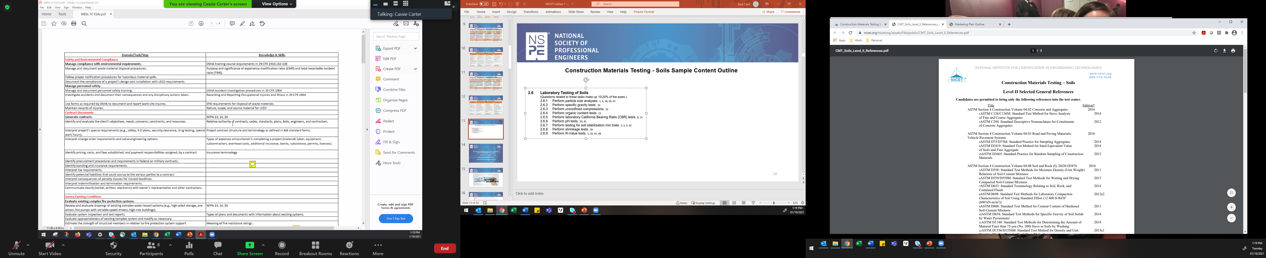
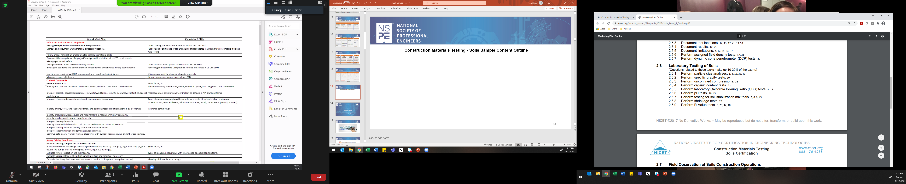
Construction Materials Testing - Soils Sample Content Outline and Reference List

Slide 13
Performance Assessments, An Essential Component of a Modern Quality Management System
Quality Standard Compliance
Performance Assessment Implementation
Performance Assessment Scope (Test Methods)

Slide 14
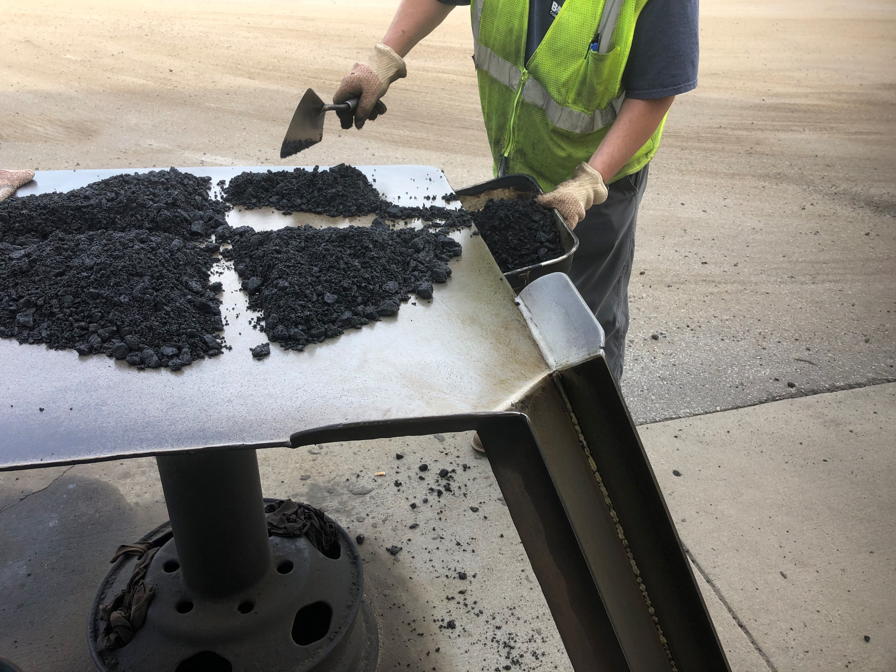
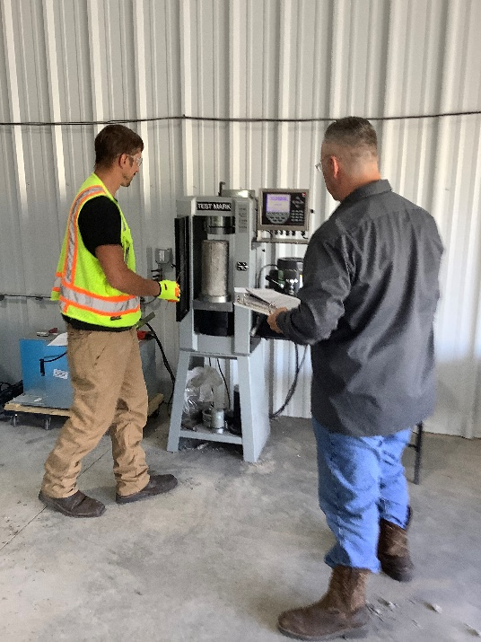

NICET Performance Examinations

Slide 15


Slide 16
AASHTO R-18 General Requirements for the Competence of Testing and Calibration Laboratories
ASTM C 1077-17 Standard Practice for Laboratories Testing Concrete and Concrete Aggregates for Use in Construction and Criteria for Laboratory Evaluation
ASTM D 3666 Standard Specification for Minimum Requirements for Agencies Testing and Inspecting Road and Paving Materials
ASTM D 3740-19 Standard Practice for Minimum Requirements for Agencies Engaged in the Testing and/or Inspection of Soil and Rock as Used in Engineering Design and Construction
ASTM E 329-20 Standard Specification for Agencies Engaged in the Testing and/or Inspection of Materials Used in Construction
ISO 17025-17 General Requirements for the Competence of Testing and Calibration Laboratories.

Slide 17
AASHTO R-18

Slide 18
ASTM C 1077-17

Slide 19
ASTM R 0030 Manual 0f Aggregate and Concrete Testing

Slide 20
ASTM D 3740-19

Slide 21
ASTM D 3740-19 continued

Slide 22
ASTM D 3666 & ISO 17025-17

Slide 23
ASTM E 329-20

Slide 24


Slide 25
An Optional Component …
Performance Examination Modules
  A NICET Two Year Pilot …..
  - Asphalt
  - Concrete
  - Soils
  - Aggregates

Slide 26
Exam Administration…
1. Examinations are administered by qualified NICET Administrators and their examiners in accordance with NICET Performance Examination Guidelines.
2. The content of the examinations are derived directly from the applicable ASTM and/or AASHTO test standards.
3. The assessment ‘checklists’ address testing methods, calculations, equipment and other criteria as specified in the standards.
4. Candidates may choose to test one or more of the modules available from the specialty areas as they see fit and applicable to the needs of their employer and jurisdiction.
5. The Administrator is responsible for processing candidate applications, fees, examination scheduling, examination administration, and reporting of results to NICET.
6. NICET will audit Administrators’ activities & maintain an accessible database of candidates, relevant results, related documentation, and validity of performance examinations.

Slide 27
Examination Administration… (continued)
7. The testing facility can be a private, government or an educational training facility testing lab as agreed upon by the NICET Administrator and the candidate’s employer or sponsor.
8. The facility must meet the minimum requirements for equipment, materials and procedures to be utilized in conducting the examinations as required by ASTM and/or AASHTO.
9. The facility must comply with all the necessary health and safety regulations as required by OSHA and State/Local authorities.
10. The performance examination must be conducted in a dedicated indoor or outdoor space free of interferences, disturbances, and distractions.
11. Examination results are reported on a Pass/Fail basis.
12. Retesting, appeals, challenges, and due process are in accordance with NICET’s Performance Examination Guidelines.

Slide 28

Application Process

Slide 29

www.nicet.org

Slide 30
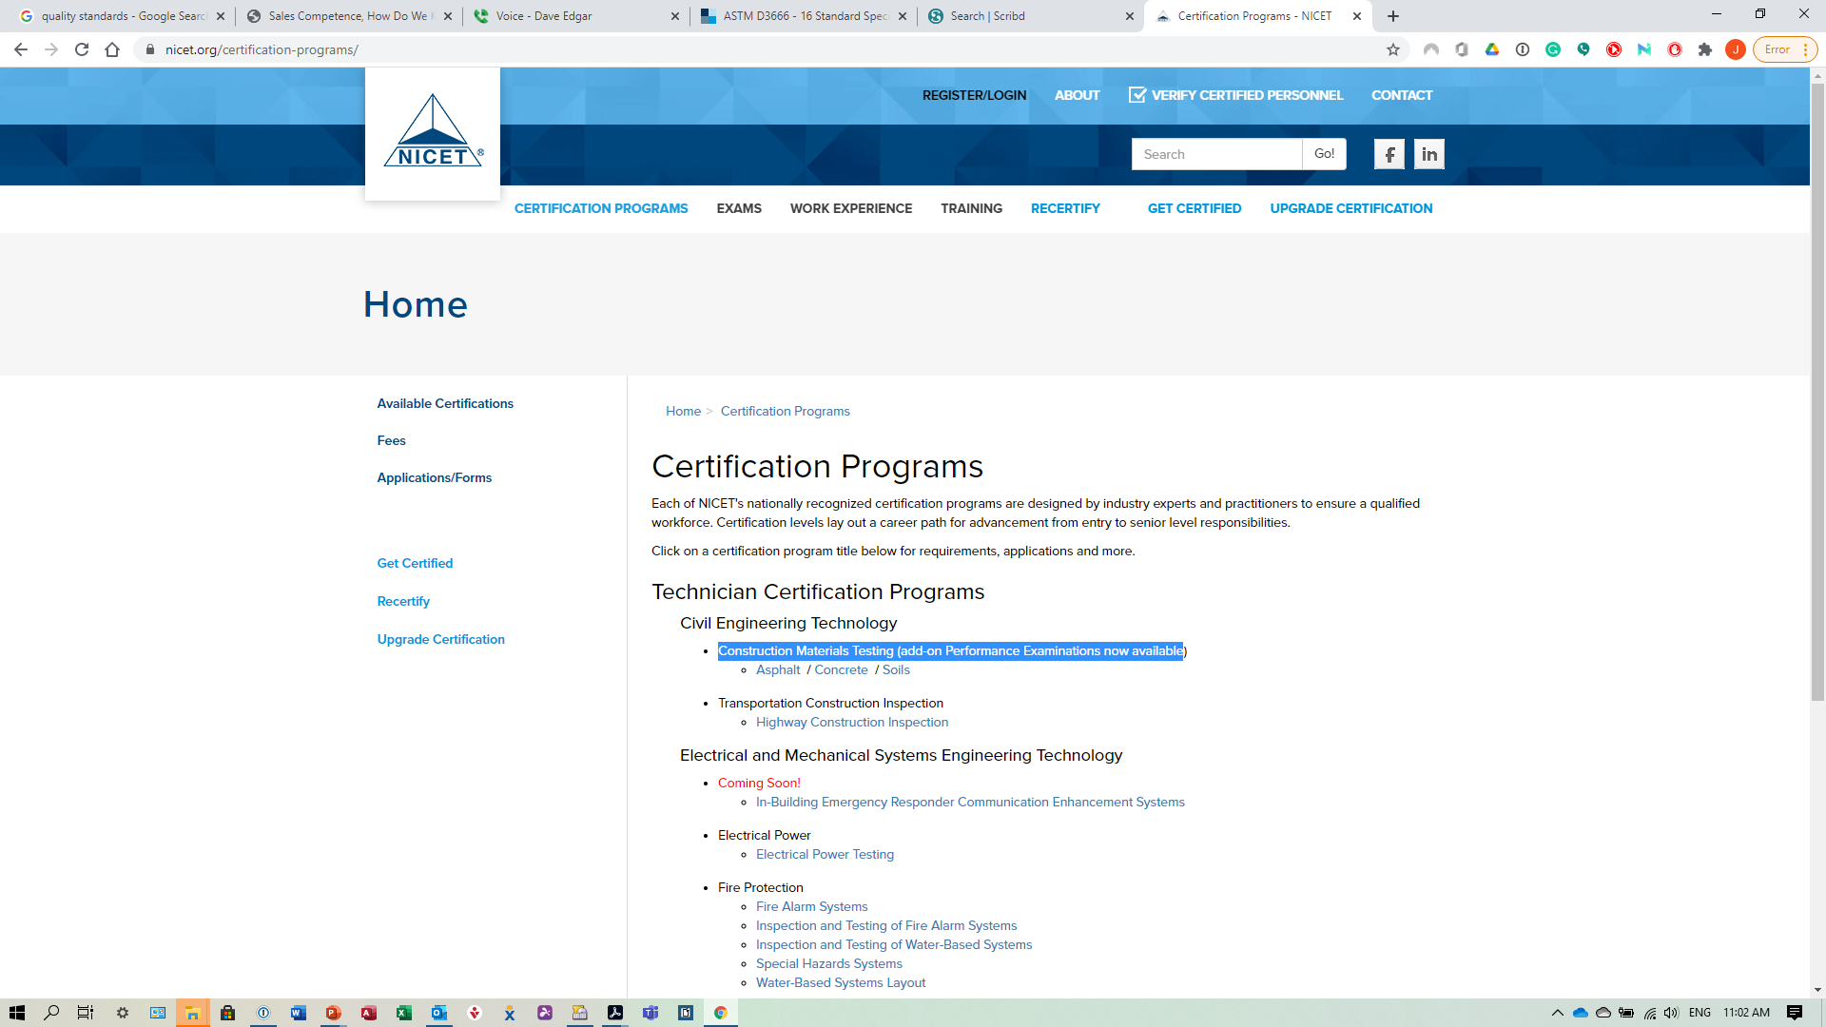
Certification Programs

Slide 31
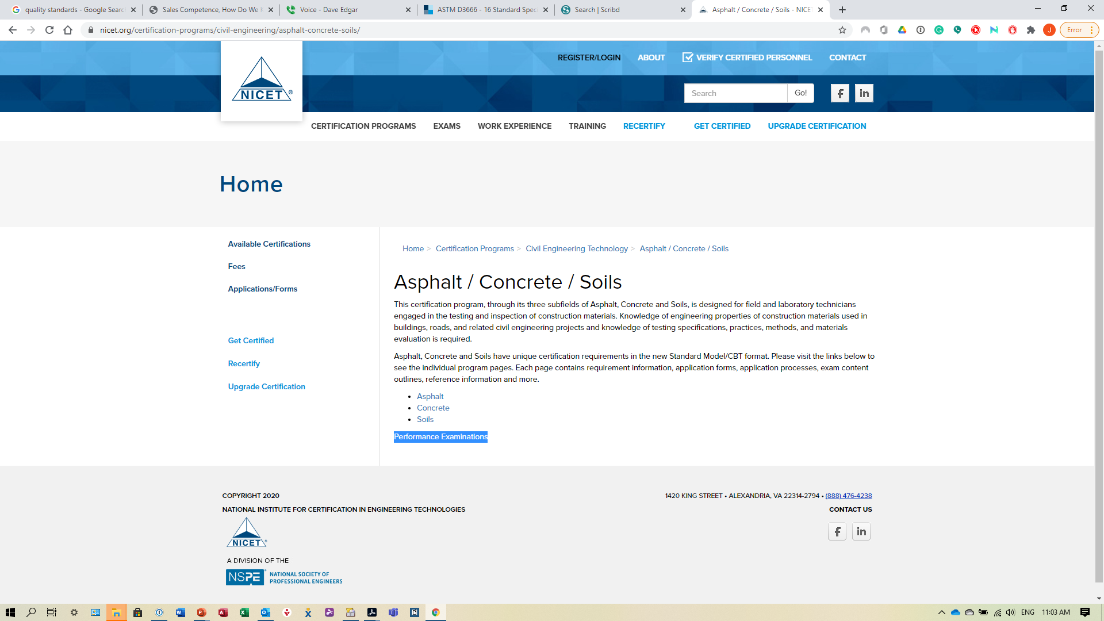
Construction Materials Testing

Slide 32
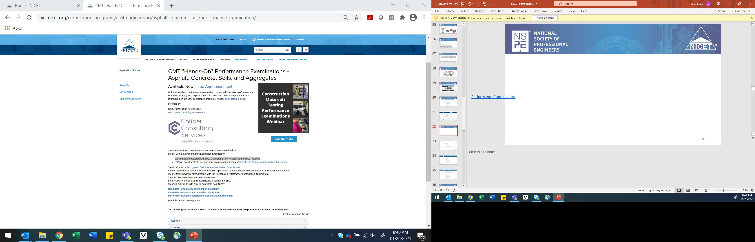
Performance Examinations

Slide 33
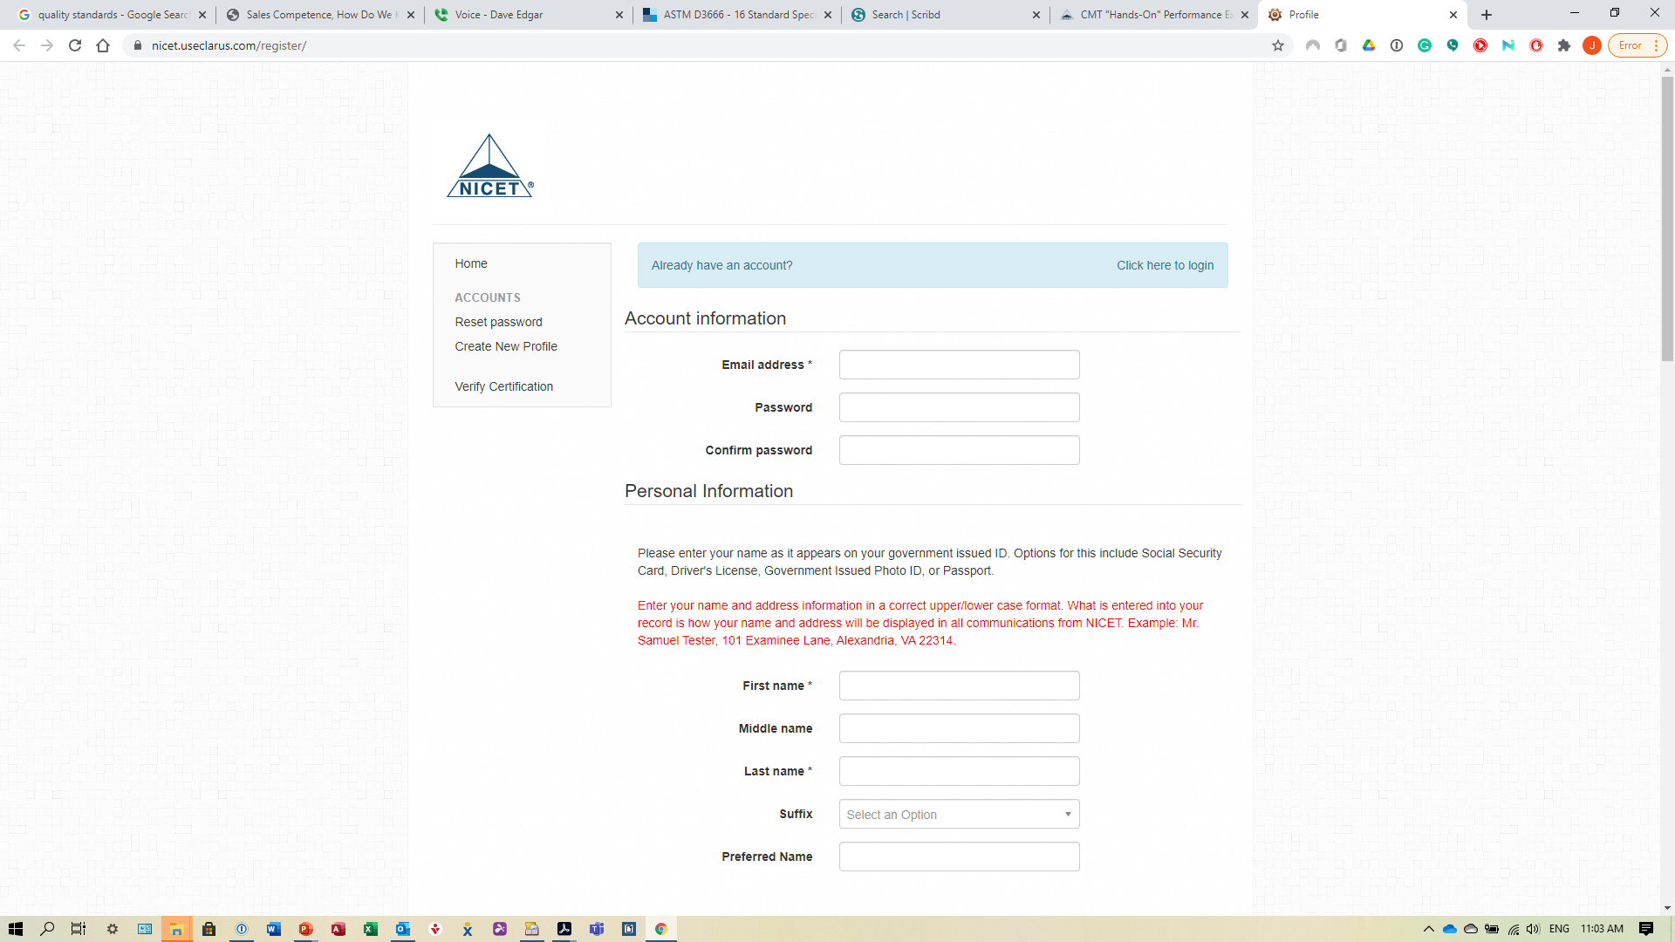
Clarus Registration/Login

Slide 34
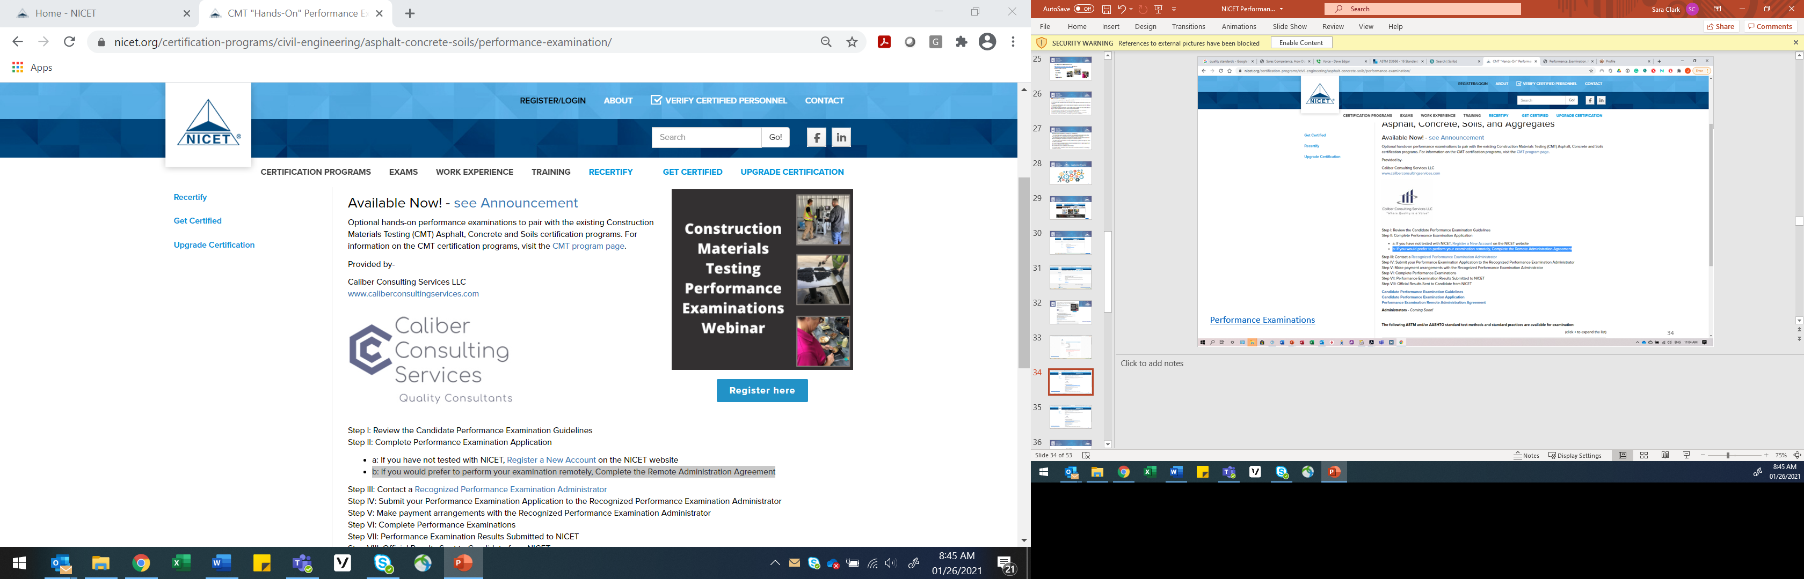
Performance Examinations

Slide 35

Performance Examinations

Slide 36

John W. Quidley
President, Caliber Consulting Services
(833) 407-1064
jquidley@c2serv.com
www.caliberconsultingservices.com
Contact Caliber Consulting Services LLC

Slide 37

Performance Examinations

Slide 38
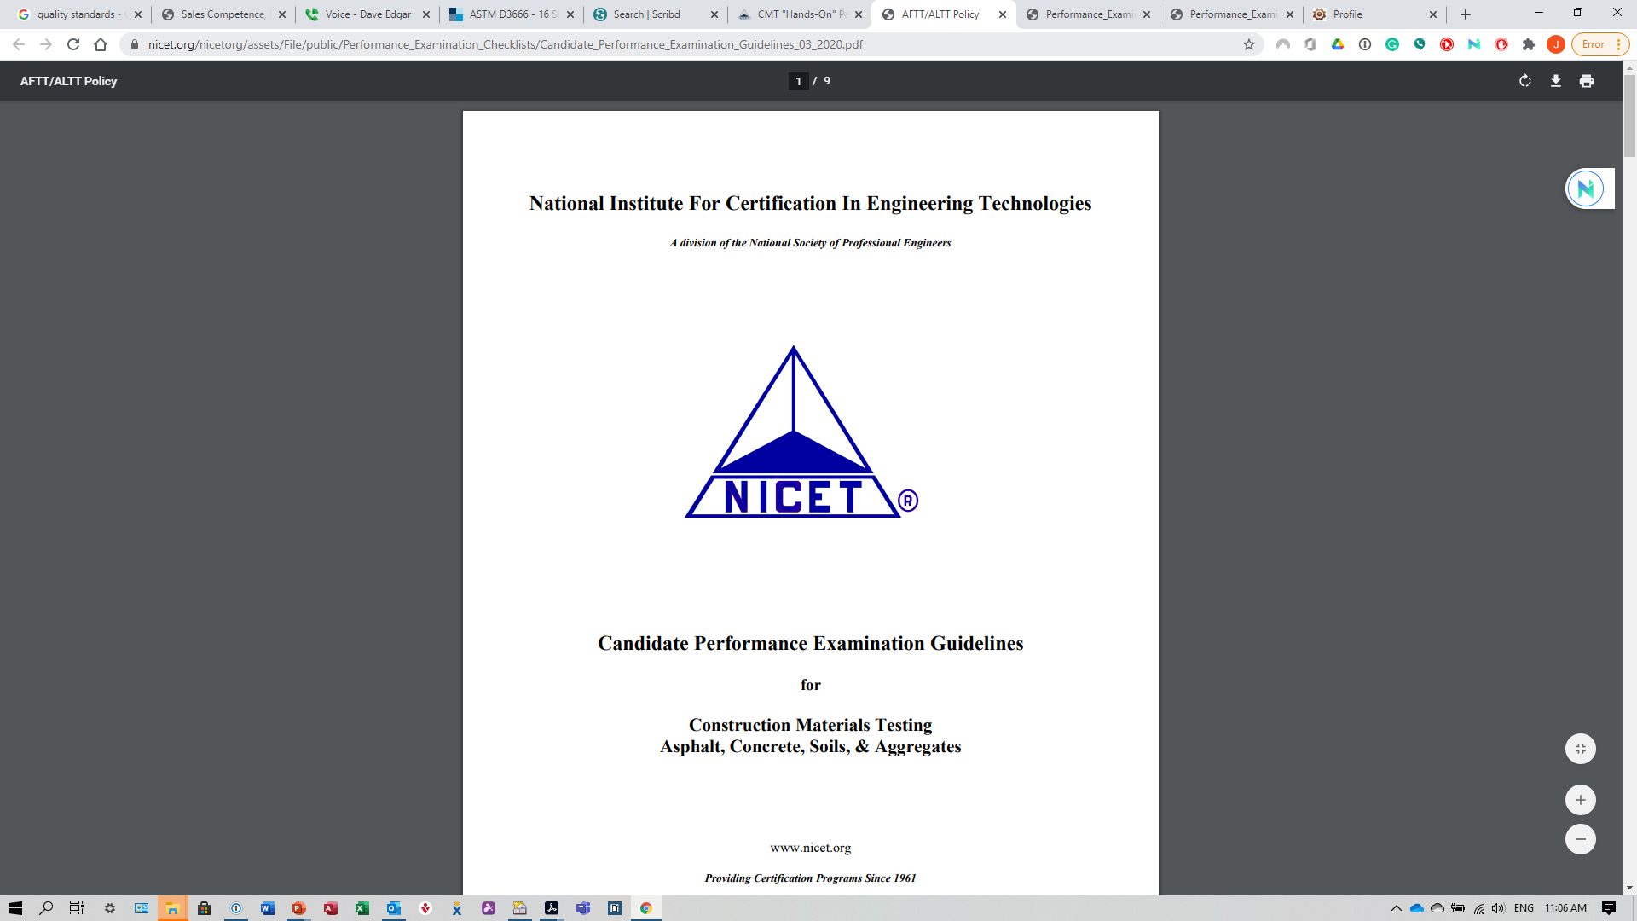
Performance Examination Guidelines

Slide 39
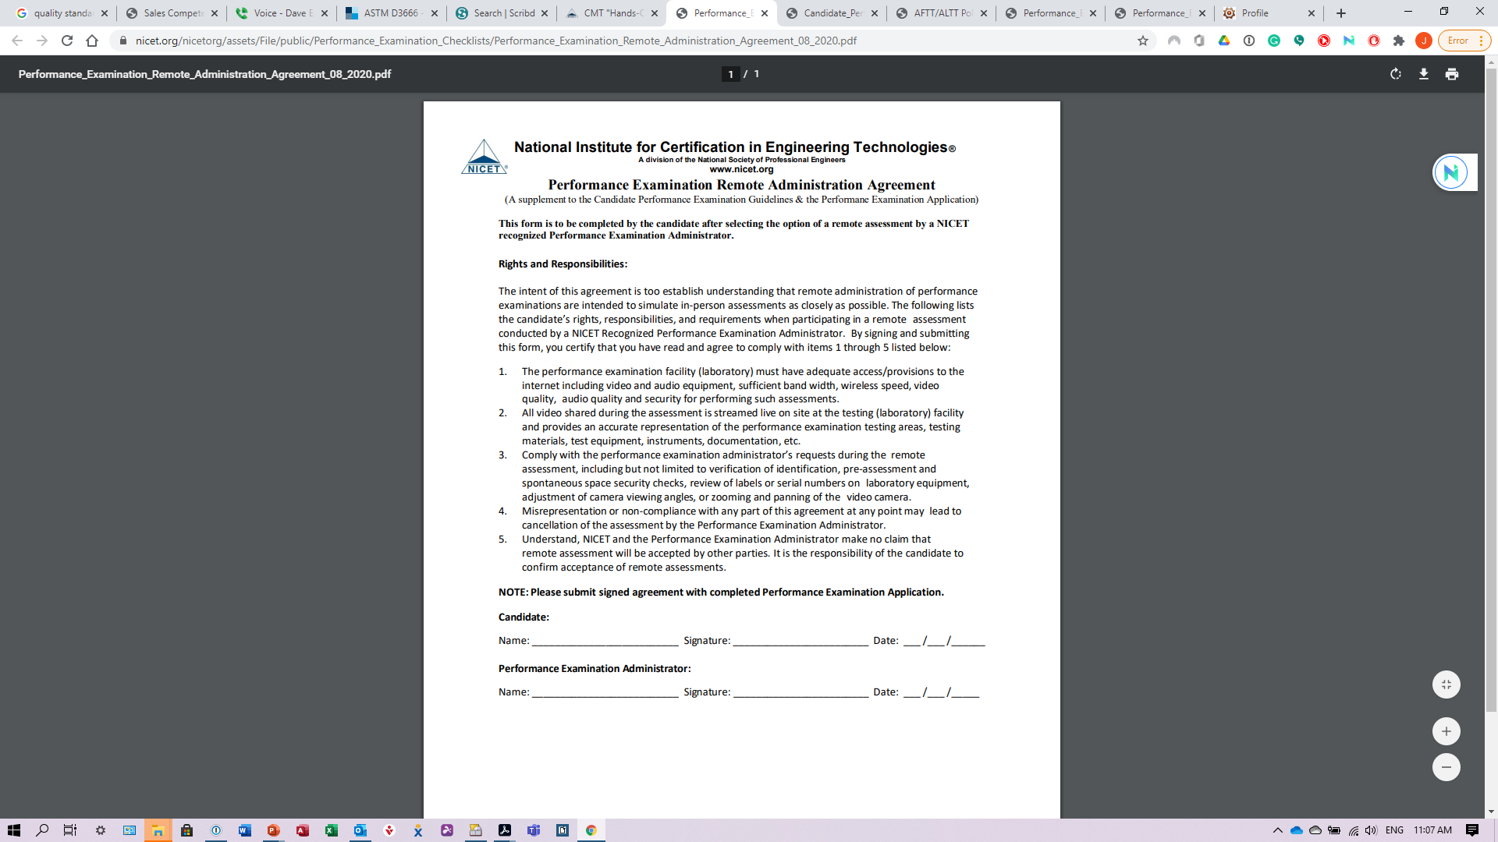
Remote Administration Agreement

Slide 40
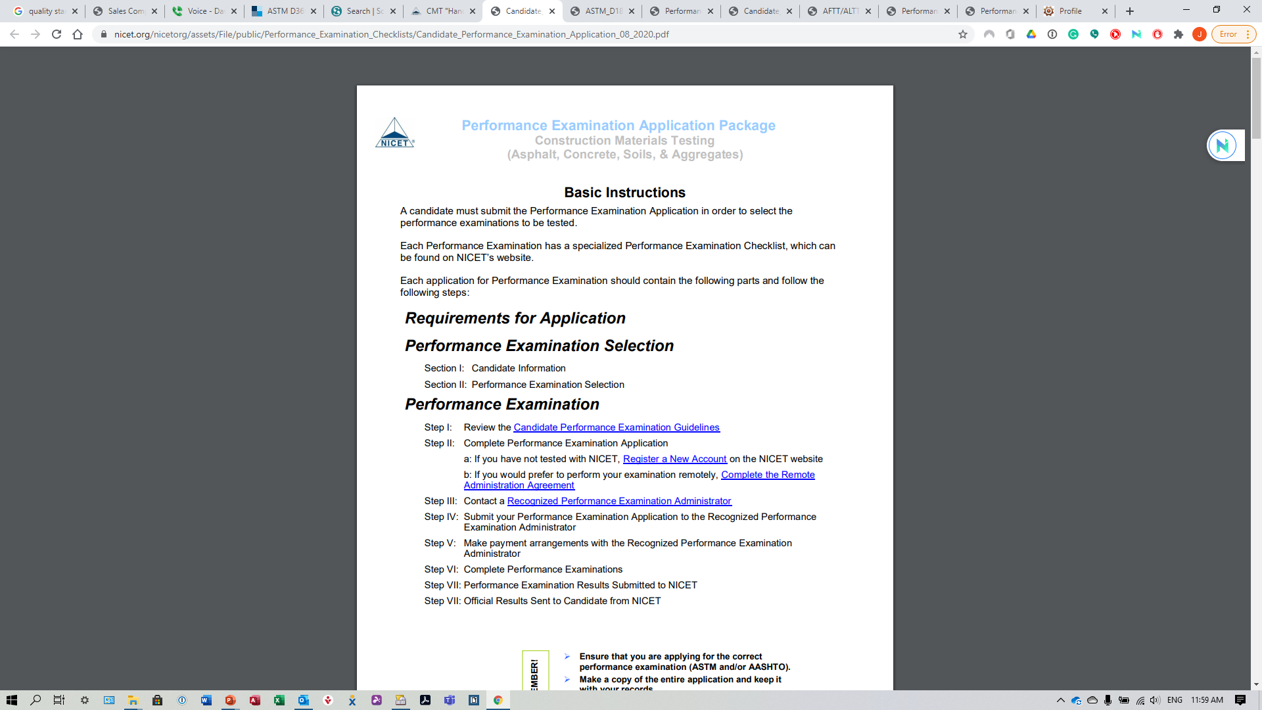
Performance Examination Application

Slide 41
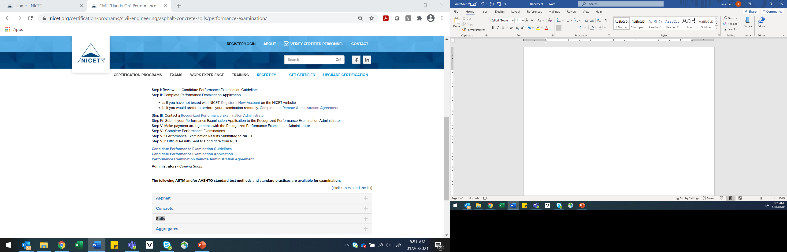
Performance Examinations

Slide 42
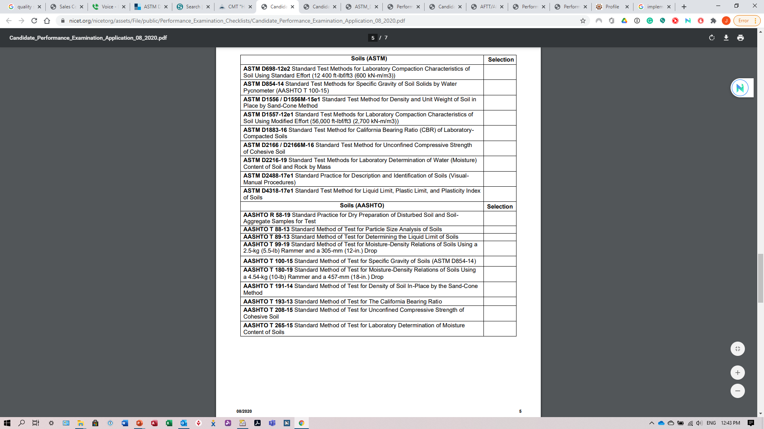
Performance Examination Application

Slide 43
John W. Quidley
President, Caliber Consulting Services
(833) 407-1064
jquidley@c2serv.com
www.caliberconsultingservices.com
Contact Caliber Consulting Services LLC

Slide 44
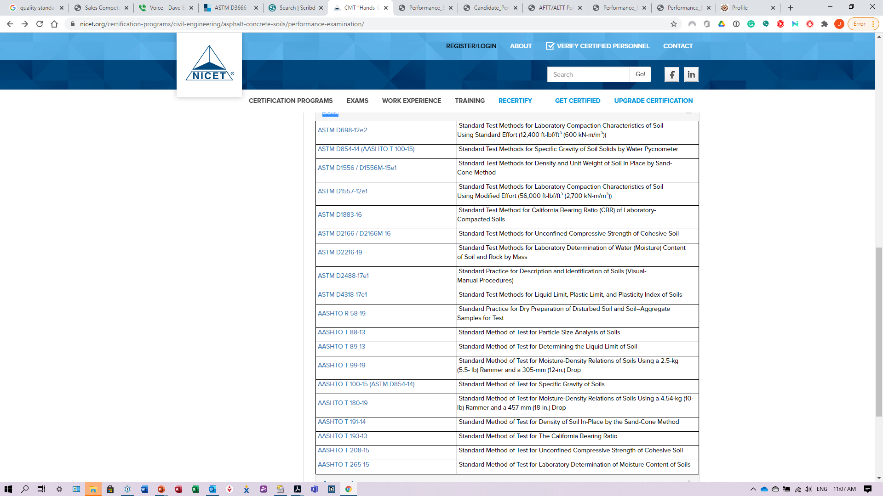
Performance Examinations

Slide 45
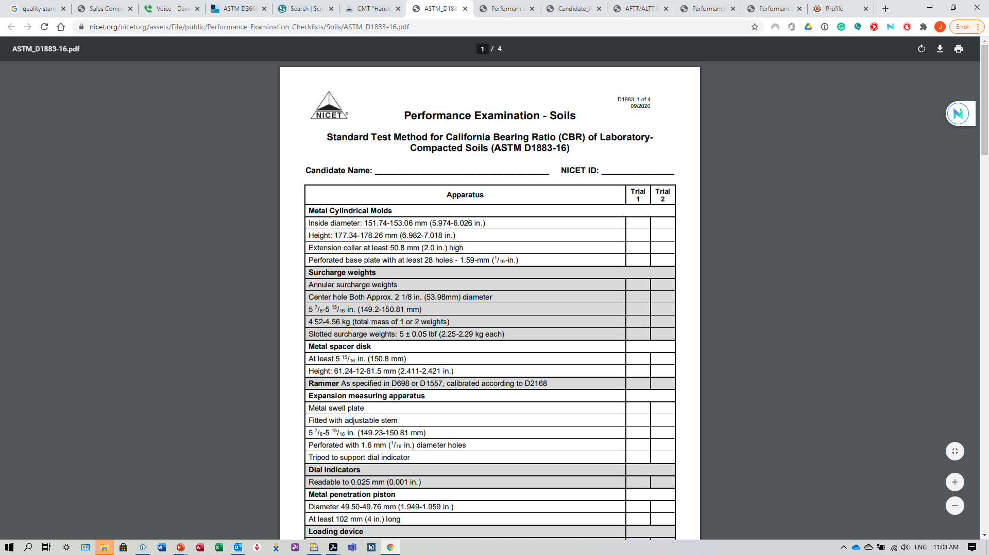
ASTM D1883-16 Checklist

Slide 46

Performance Examination Test Methods

Slide 47
Asphalt Modules…
  Density of Bituminous Concrete in Place by Nuclear Methods
  Bulk Specific Gravity and Density of Compacted Bituminous Mixtures Using Coated Samples
  Theoretical Maximum Specific Gravity and Density of Bituminous Paving Mixtures
  Preparation and Determination of the Relative Density of Asphalt Mix Specimens by Means of the Gyratory Compactor
  Asphalt Content of Asphalt Mixtures by the Ignition Method
  Asphalt Content of Bituminous Mixtures by the Nuclear Method
  Quantitative Extraction of Asphalt Binder from Asphalt Mixtures
  Mechanical Size Analysis of Extracted Aggregate
  Moisture or Volatile Distillates in Asphalt Mixtures
Performance Examinations

Slide 48
Concrete Modules…
Sampling Freshly Mixed Concrete
Making and Curing Concrete Test Specimens in the Field
Temperature of Freshly Mixed Hydraulic-Cement Concrete
Slump of Hydraulic-Cement Concrete
Density (Unit Weight), Yield, and Air Content (Gravimetric) of Concrete
Air Content of Freshly Mixed Concrete by the Volumetric Method
Air Content of Freshly Mixed Concrete by the Pressure Method
Capping Cylindrical Concrete Specimens
Use of Un-bonded Caps in Determination of Compressive Strength of Hardened Cylindrical Concrete Specimens
Compressive Strength of Cylindrical Concrete Specimens
Flexural Strength of Concrete (Using Simple Beam with Third-Point Loading)
Performance Examinations

Slide 49
Soils Modules…
  Classification of Soils for Engineering Purposes (United Soil Classification System)
  Description and Identification of Soils (Visual-Manual Procedures)
  Laboratory Determination of Water (Moisture) Content of Soil and Rock by Mass
  Determination of Water Content of Soil and Rock by Microwave Oven Heating
  Determination of Water Content of Soil by Direct heating
  Field Determination of Water (Moisture) Content of Soil by the Calcium Carbide Gas Pressure Tester
  Liquid Limit, Plastic Limit, and Plasticity Index of Soils
  Particle Size Distribution (Gradation) of Soils Using Sieve Analysis
  Determining the Amount of Material Finer than 75-m (No. 200) Sieve
  Particle-Size Distribution (Gradation) of Fine-Grained Soils Using the Sedimentation (Hydrometer) Analysis
Performance Examinations

Slide 50
Soils Modules… (continued)
  Specific Gravity of Soil by Water Pycnometer
  Moisture, Ash, and Organic Matter of Peat and other Organic Soils
  Laboratory Compaction Characteristics of Soils Using Standard Effort (12,400 ft-lbf/ft³)
  Laboratory Compaction Characteristics of Soils Using Modified Effort (56,000 ft-lbf/ft³)
  Density and Unit Weight of Soils in Place by Sand-Cone Method
  In-Place Density and Moisture Content of Soil and Soils-Aggregate by Nuclear Method (Shallow Depth)
  Correction of Unit Weight and Water Content for Soils Containing Oversize Particles
  California Bearing Ratio (CBR) of Laboratory Compacted Soils
  Unconfined Compressive Strength of Cohesive Soils.
  Soil Compaction Determination at Shallow Depths Using 5-lb (2.3 kg) Dynamic Cone Penetrometer
Performance Examinations

Slide 51
Aggregates Modules…
  Reducing Samples of Aggregate to Testing Size
  Surface Moisture in Fine Aggregate
  Total Evaporable Moisture Content of Aggregate by Drying
  Liquid Limit, Plastic Limit, and Plasticity Index – one & multi point
  Sand Equivalent Value of Soils & Fine Aggregates
  Material Finer than 75-um (No. 200) Sieve in Mineral Aggregates by Washing
  Sieve Analysis of Fine and Coarse Aggregates
  Bulk Density (Unit Weight) and Voids in Aggregate
  Relative Density (Specific Gravity) and Absorption of Coarse Aggregates
Performance Examinations

Slide 52
Aggregates Modules… (continued)
  Relative Density (Specific Gravity) and Absorption of Fine Aggregates
  Flat Particles, Elongated Particles. Or Flat and Elongated Particles in Coarse Aggregates
  Clay lumps & Friable Particles in Aggregates
  Lightweight Particles in Aggregate
  Soundness of Aggregates by Use of Sodium Sulphate or Magnesium Sulphate
  Organic Impurities in Fine Aggregates for Concrete
  Resistance to Degradation of Small-Size Coarse Aggregates by Abrasion and Impact in the Los Angeles Machine
  Uncompacted Void Content of Fine Aggregate
Performance Examinations

Slide 53

Questions?
John W. Quidley
President, Caliber Consulting Services LLC
Office: 833-407-1064
Email jquidley@c2serv.com
Website www.caliberconsultingservices.com
Sara B. Clark
Manager, Certification Program Development
1420 King Street, Alexandria VA 22314-2794
Toll-free: (888) 476-4238 x119
Local: (703) 548-1518 x119
sclark@nicet.org
www.nicet.org

